Slide 1

Heart Disease Diagnostic Analysis
SHAIK SHEERU ALI MOULALI
UNID: UM/IP/1947
Position: Data Analyst Intern

Slide 2
Introduction
Heart disease: It is also known as cardiovascular disease, refers to a class of diseases that involve the heart or blood vessels. It is a broad term that encompasses various conditions, with coronary artery disease being the most common type.
Heart Disease Diagnostics:
1. Medical History and Physical Examination, 2. Blood Tests, 3. Electrocardiogram (ECG or EKG), 4. Echocardiogram, 5. Stress Test, 6. Coronary Angiography, 7. Cardiac CT or MRI.
Causes of Heart Disease:
1. Age, 2. Atherosclerosis, 3. Hypertension (High Blood Pressure), 4. Diabetes, 5. Smoking, 6. Obesity, 7. Physical Inactivity, 8. Unhealthy, 8. Genetics.

Slide 3
Attributes of Heart Disease Diagnostic Analysis
Age: The age of the individual
Sex: Gender (Male/Female)
Chest Pain Type: Type of chest pain (4 Values)
Resting Blood Pressure: Resting blood pressure in mm Hg
Serum Cholesterol: Serum cholesterol in mg/dl
Fasting Blood Sugar: Fasting blood sugar level (>120 mg/dl)
Resting Electrocardiographic Results: Resting electrocardiographic results (0, 1, 2)
Maximum Heart Rate Achieved: Maximum heart rate achieved during exercise
Exercise-Induced Angina: Presence of exercise-induced angina (Yes/No)
Old_peak: ST depression induced by exercise relative to rest
Slope of Peak Exercise ST Segment: Slope of the peak exercise ST segment
Number of Major Vessels Colored by Fluoroscopy: Number of major vessels colored by fluoroscopy (0-3)
Thal: Thalassemia (0 = normal, 1 = fixed defect, 2 = reversible defect)

Slide 4
Main KPIs:
HDP (Heart Disease Percentage): 54.30%
AC (Average Cholesterol): 246.50
AHR (Average Heart Rate): 149.57
ABP (Average Blood Pressure): 131.60

Slide 5
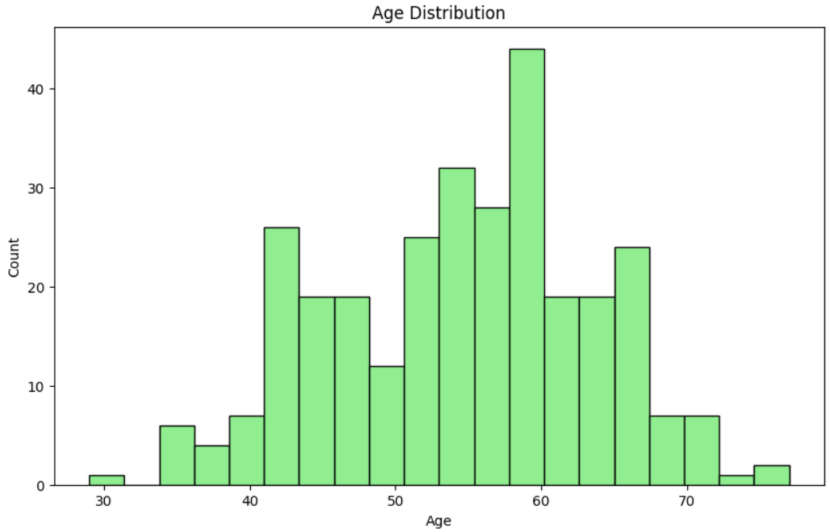
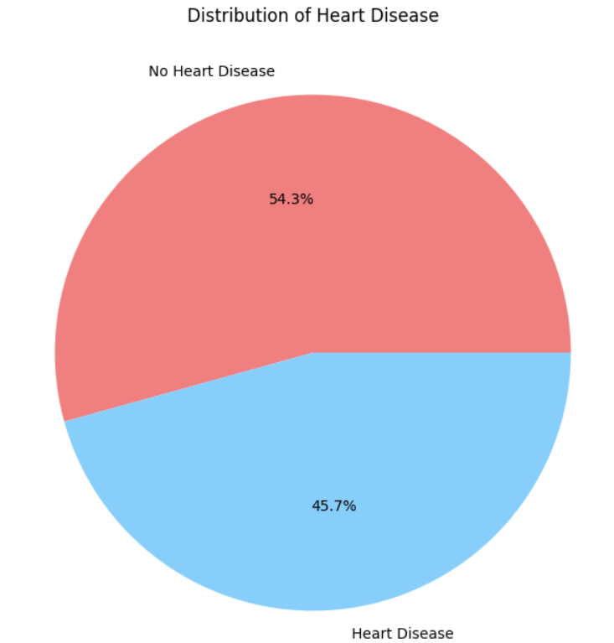
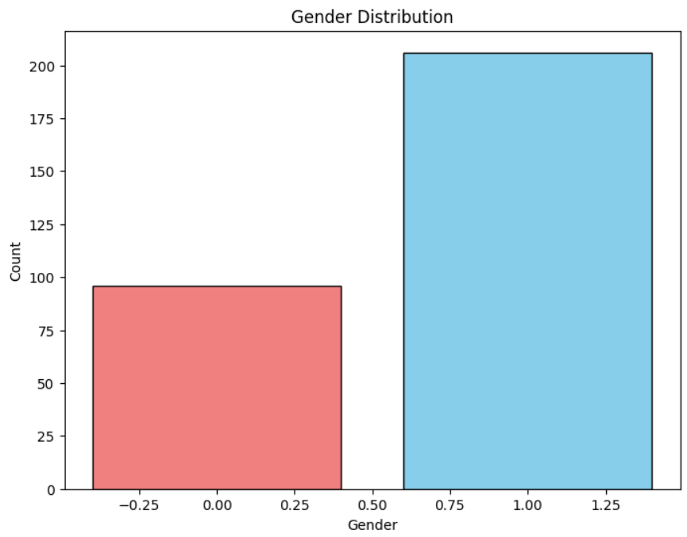
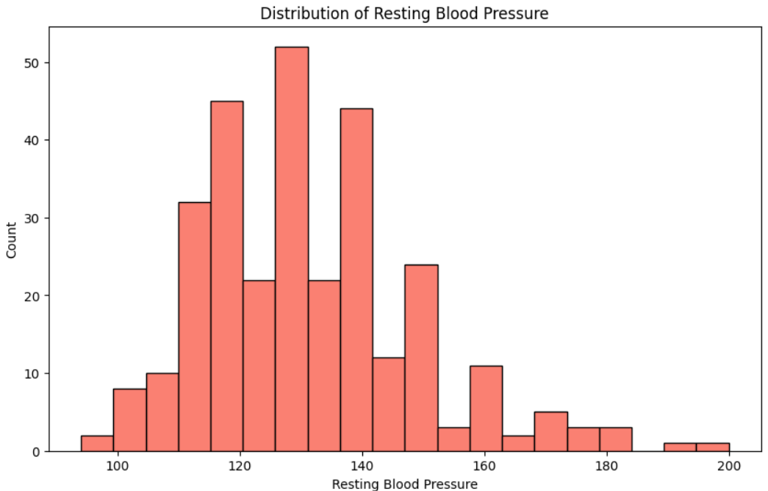
Worksheets:

Slide 6
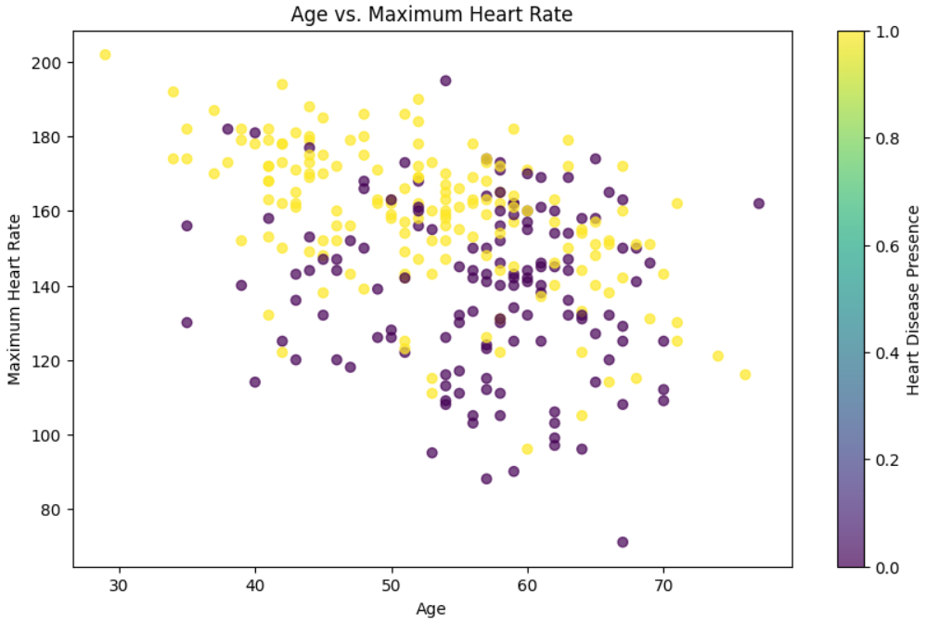
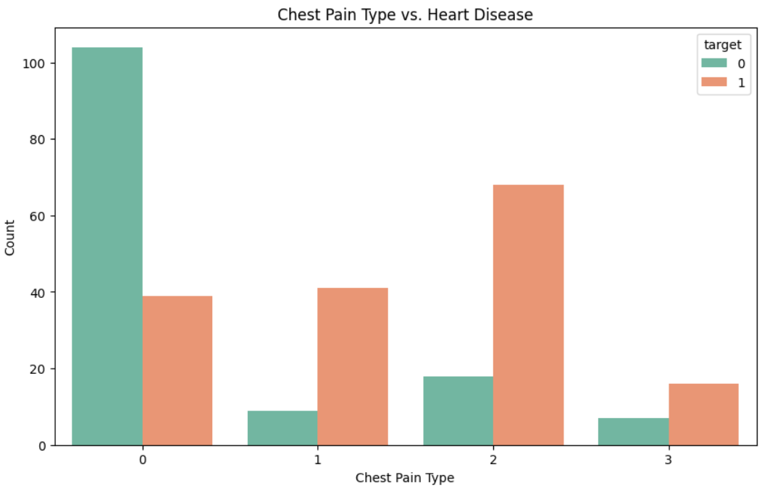
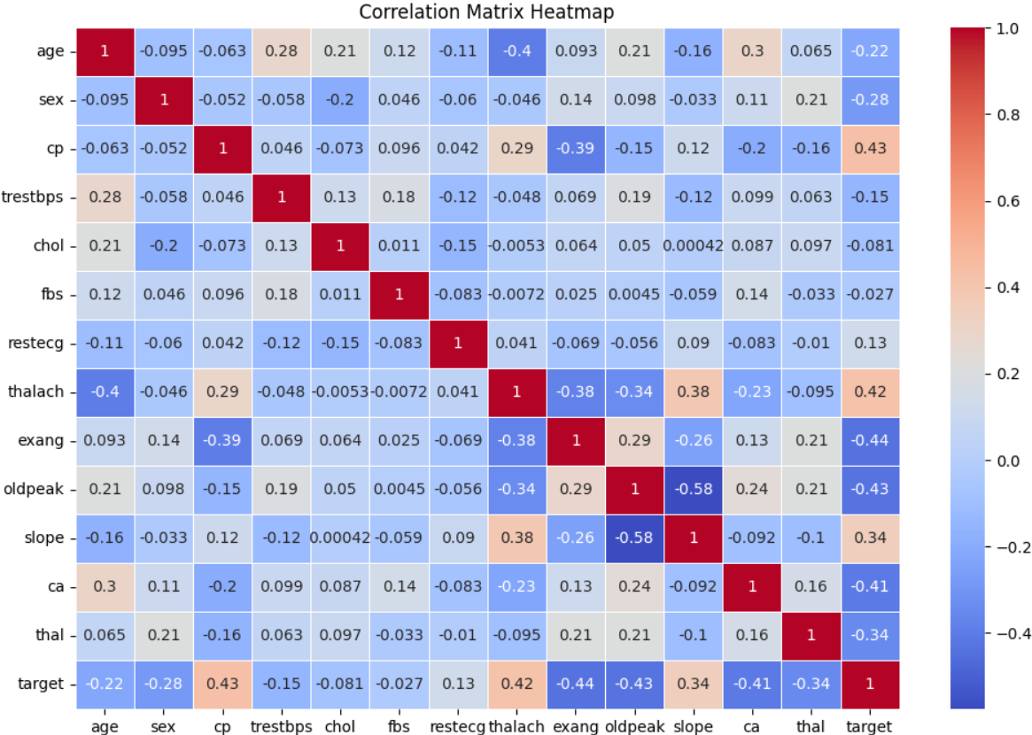
Worksheets:

Slide 7
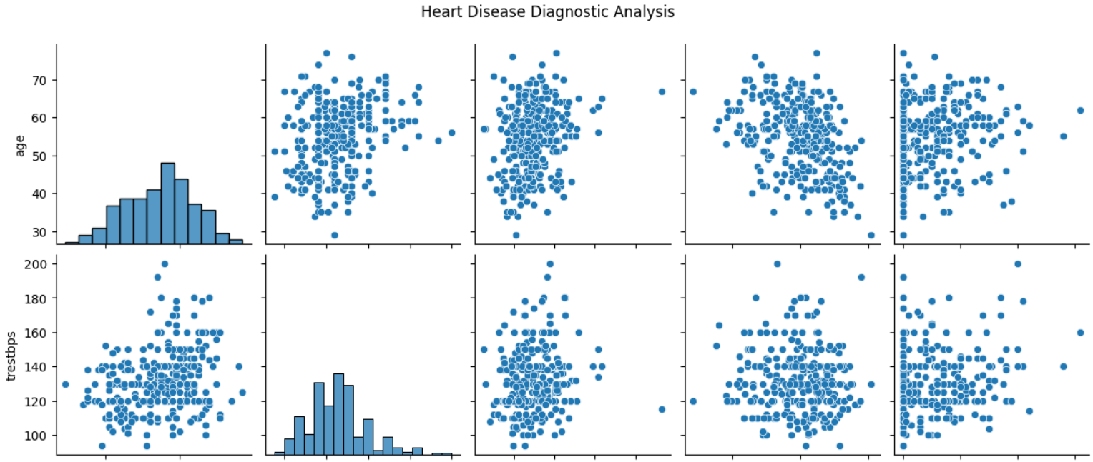
Worksheets:

Slide 8
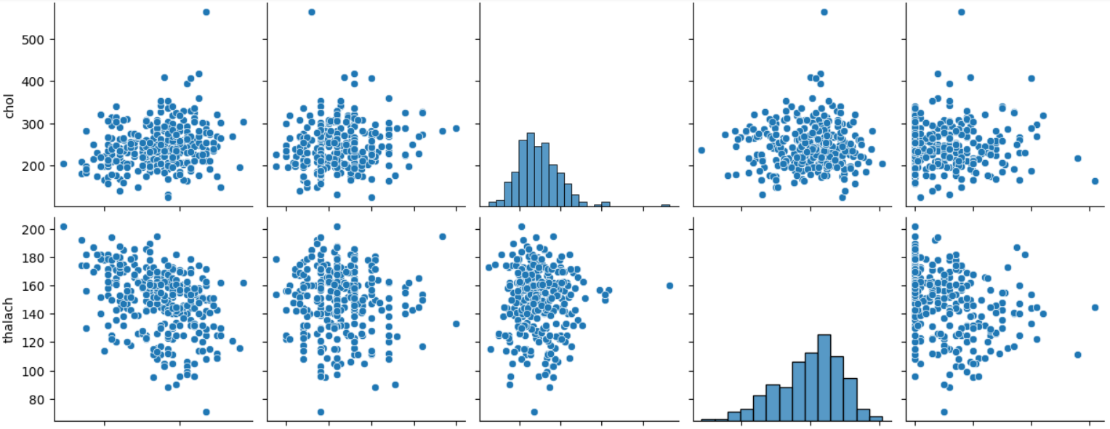
Worksheets:

Slide 9
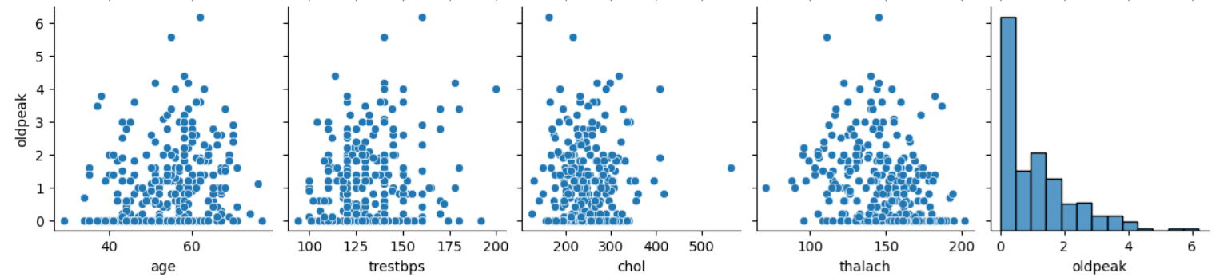
Worksheets:

Slide 10
thank you
GitHub Link: https://github.com/ShaikSheeru2001/Project_10_Heart-Disease-Diagnostic-Analysis

